Slide 1
SRI RAMAKRISHNA ENGINEERING COLLEGE
[Educational Service : SNR Sons Charitable Trust]
[Autonomous Institution, Accredited by NAAC with ‘A’ Grade]
[Approved by AICTE and Permanently Affiliated to Anna University, Chennai]
[ISO 9001-2015 Certified and all eligible programmes Accredited by NBA]
VATTAMALAIPALAYAM, N.G.G.O. COLONY POST, COIMBATORE – 641 022.
Department of Electronics and Communication Engineering
16EC258-MINIPROJECT II
No. of Credits : 2
MP-2

Slide 2
SRI RAMAKRISHNA ENGINEERING COLLEGE
Class / Section / Semester | : | III ECE / B / V
Batch | : | 2019 - 2023
Project Review | : | Second Review
Title of the project | : | Health Monitoring and Infection Probability Prediction for COVID Patients.
Date | : | 10.01.2022
Project Guide | : | Mr.M.Selvaganesh AP/ECE
Team Members | : | 1.Karthik R.P. (1902103) 2.Nitish Kumar V.A. (1902135) 3.Prashanna Moorthy S.R. (1902142)
MP-1

Slide 3
PROBLEM STATEMENT
During peak periods of COVID the availability of beds for the COVID patient in hospitals became rare, so there occurs a situation where the affected person should be taken care at home from a safer distance and their guardian or doctor are in need to monitor the patient’s body vitals and oxygen level in the oxygen cylinder. This situation becomes more crucial when there is sudden increase in the patients body vitals. During this situation the person who is taking care of the patient may get affected, so they are in need to monitor the patient from a safer distance. This is the main problem we are attempting to solve so that the single person medical assistance could be effective.
MP-2

Slide 4
CONCEPT AND SCOPE OF SOLUTION
CONCEPT OF SOLUTION:
To develop a health monitoring system to monitor the body vitals.
Oxygen cylinder level monitoring and creating alerts notification through Mobile Application.
Machine Learning-based prediction of COVID-19, based on person's health condition.
SCOPE OF SOLUTION:
The complete set-up of health monitoring system makes sure that the patient is in normal condition. The system alerts the care taker in case of emergency.
The whole idea mainly ensures that ,there is no contact between patient and others, this will be a effective solution for home quarantine of covid patients. Most of existing systems are used in hospital by the professional doctors, This system can be used by normal person for taking care of covid patients at home.
MP-2

Slide 5
LITERATURE SURVEY
S.NO | TITLE | APPROACH | REMARKS
1) | A Novel Patient Monitoring System Using Photoplethysmography(PHP) and IOT in the Age of COVID-19 AUTHORS: Anamika Chauhan,Kunal Farmah, Abhay Goel, Akul Gandotra IEEE,2021 | This project provides the solution to tackle the issue of remote patient monitoring comprises of the implementation of an Android Application that is capable of measuring vital signs, such as Heart Rate and Oxygen Saturation (SPO2) using a technique known as Photoplethysmography via the smartphone camera. | Here, Only the body vitals of the patient is shown via Andriod application in smartphones. But in our project, creating alert in unstable condition and predicting infection probability is novel.

Slide 6
LITERATURE SURVEY
S.NO | TITLE | APPROACH | REMARKS
2) | Monitoring Self-isolation Patient of COVID-19 with Internet of Things AUTHORS: Rinto Priambodo (Faculty of Computer Science, Universitas Mercu Buana, Indonesia) Trie Maya Kadarina IEEE,2021 | A monitoring system for COVID-19 patients in self-isolation to monitor physiological data like SpO ₂ and heart rate together with location information of the patients. They developed IoT-based health monitoring system with wireless body sensor networks and a gateway that can be used for data acquisition and transmission. | In this project, the body vitals is shown along with the location of the patient and addressed through Iot monitoring system.

Slide 7
LITERATURE SURVEY
S.NO | TITLE | APPROACH | REMARKS
3) | ANN based COVID -19 Prediction and Symptoms Relevance Survey and Analysis AUTHORS: Dharani N, Kirupa Krishnan G IEEE(ICCMC),2021 | The required objective is obtained using complex machine learning algorithms that are able to predict, up to an extent the probability that the person has covid-19 and also if the related covid-19 symptoms provided are relevant to the condition or not. | Here, Using the body vitals of the patient and ML, the COVID 19 prediction is alone done with approximate results. But In our project COVID prediction is done through Logarithmic regression with accurate results.

Slide 8
EXISTING METHOD
The existing method of patient health monitoring system is viewing the patient body vitals locally in the device connected to patient. The implementation of IOT in health monitoring ,makes us only to view the patient's status.
MP-2

Slide 9
PROPOSED / INNOVATIVE METHOD
Most of existing systems are used in hospital by the professional doctors, our system can be used by normal person for taking care of covid patients at home.
Monitoring oxygen cylinder level through Mobile Application and creation alert in unstable condition is our innovative method along with the health monitoring. This can be used as a compact devices.
A new approach is to build a ML model by transferring patient’s raw data, which is monitored and it gives high prediction accuracy. This is a cost effective way for taking care of covid patients even after their post covid observation at home.
MP-2

Slide 10
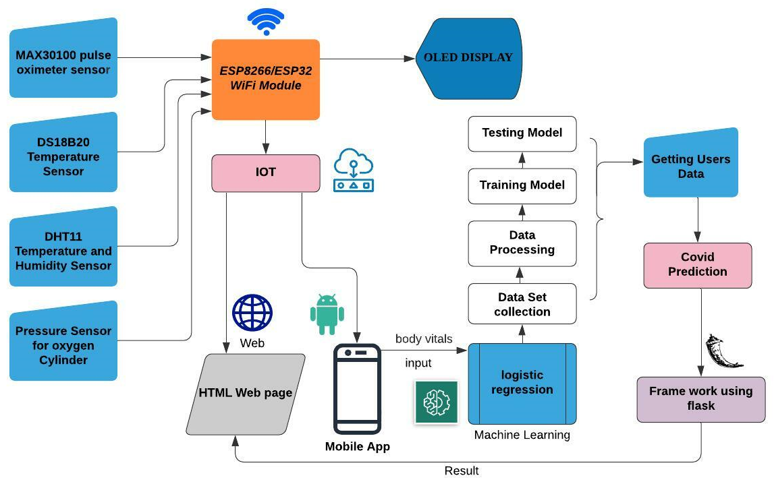
BLOCK DIAGRAM
MP-1

Slide 11
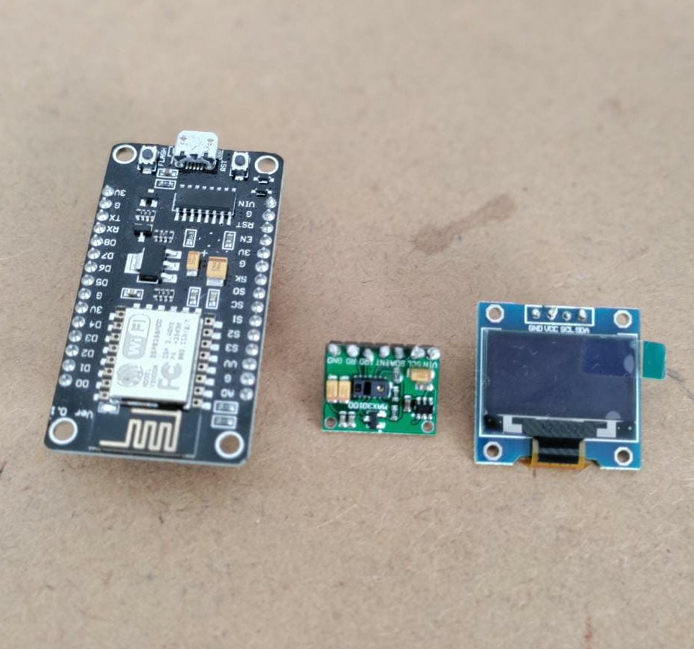
HARDWARE USED
Hardwares used:
ESP32 Module – used for overall operation,controlling and interfacing of all sensors.
Pulse Oximeter(max30100) – measures heartbeat and blood oxygen
level
Temperature probe(ds18b20) – measures
body temperature
Pressure sensor – obtains oxygen
cylinder level.
OLED display(128x64) – displays
collected body vitals.
DHT11 – measures temperature and
humidity of the patient’s environment.
MP-1

Slide 12
HARDWARE IMPLEMENTATION
The system is implemented using the combination of hardware components.
The block diagram of the developed system demonstrated here and all the sensors are connected with ESP32 using physical pins.
ESP32 is used as a processing device as it has a built-in Wi-Fi module. For all sensors, the Vcc and GND are connected with the Vcc and GND pin of ESP32. MAX30100 sensor, is used to monitor the Heart rate and SpO2 of patients.
For room condition monitoring,DHT11 sensor is used.
DS18B20 is used for monitoring body temperature.
MP-2

Slide 13
SOFTWARE USED
Coding platform : Google Colab.
WebPage : Front-end – HTML5 ,CSS
Back-end – Python
Framework : flask
Libraries(python) :pandas, numpy, scikit-learn
Algorithm used :Logistic Regression
Software used :Visual studio code
MP-1

Slide 14
SOFTWARE IMPLEMENTATION
A Machine Learning Based Approach on Predicting COVID-19:
This method summarizes that the patient is infected or not from COVID-19.
Firstly, we create a model for checking the probability of patient i.e, higher the probability higher chances of infection.
Secondly, after creating a model we integrate it into flask app and predicting the result for COVID19.
MP-2

Slide 15
SOFTWARE IMPLEMENTATION
The Machine learning model predicts the infection probability of covid patients based on the input parameters.
Body temperature ,O2 saturation value, body pain, travel history, age, loss of taste and smell, vomiting, diarrhea – these are the input parameters used in this model. These parameters are used to predict the infection probability.
Based on the dataset used in this model gives a good level of accuracy.
Logistic regression is a supervised learning classification algorithm used to predict the probability of a target variable. It is one of the simplest ML algorithms that can be used for various classification problems such as Diabetes prediction, cancer detection etc.
MP-1

Slide 16
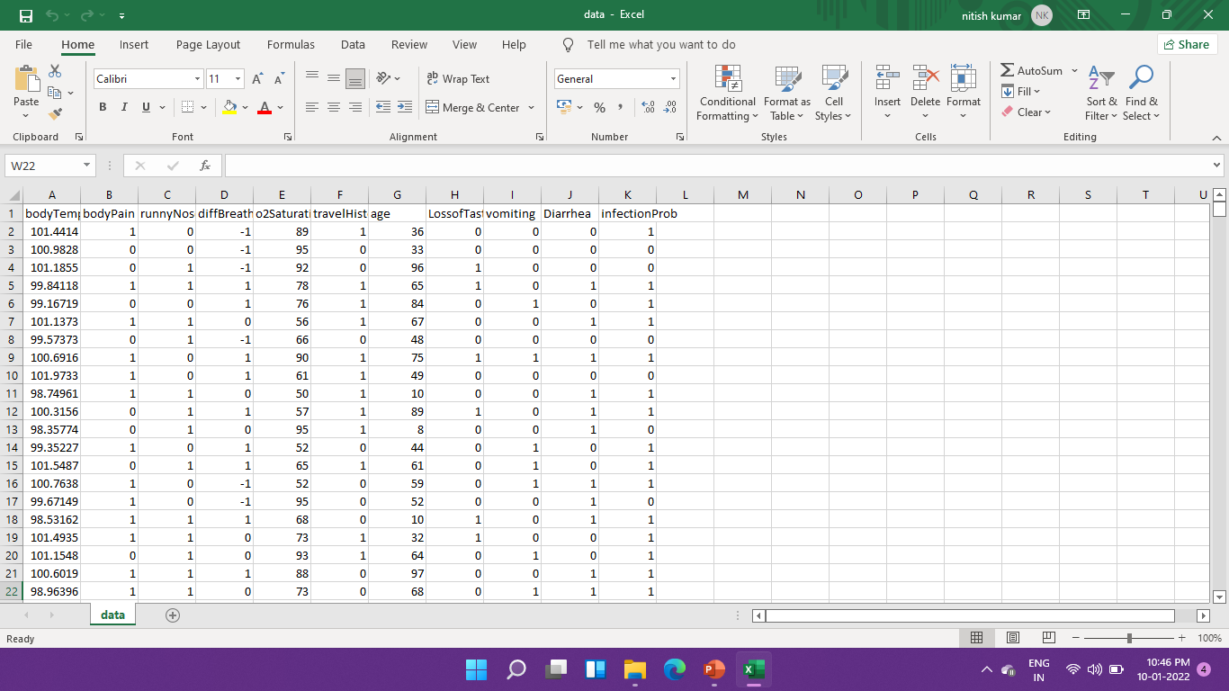
SOFTWARE IMPLEMENTATION
MP-1

Slide 17
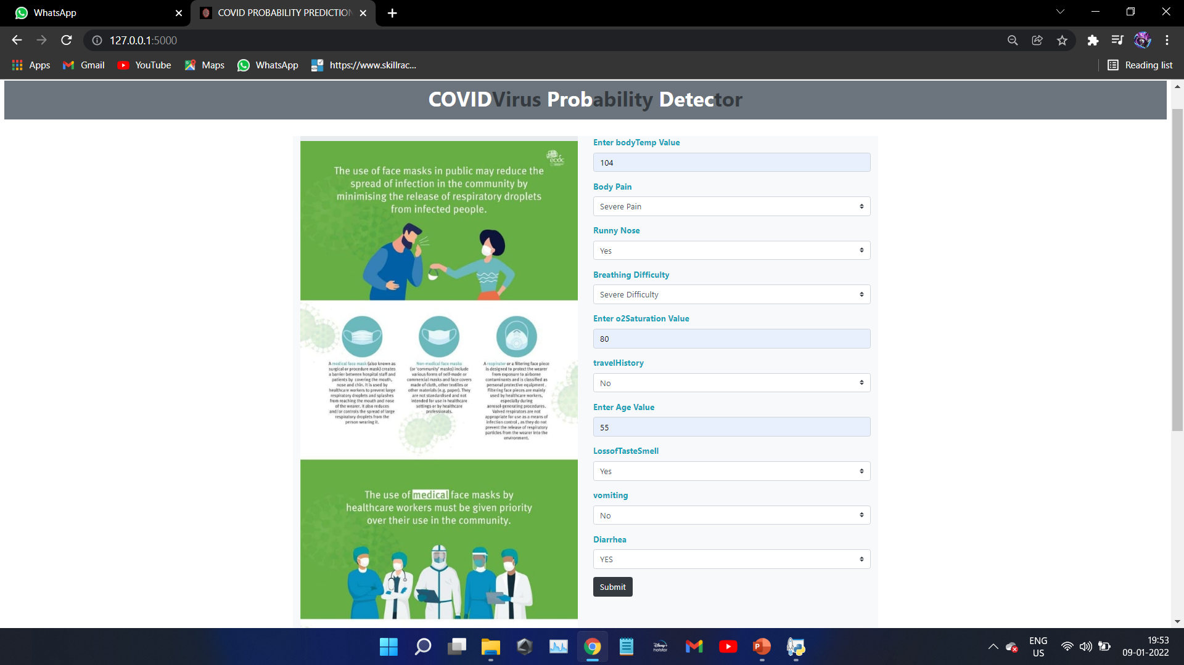
SOFTWARE IMPLEMENTATION
MP-2

Slide 18
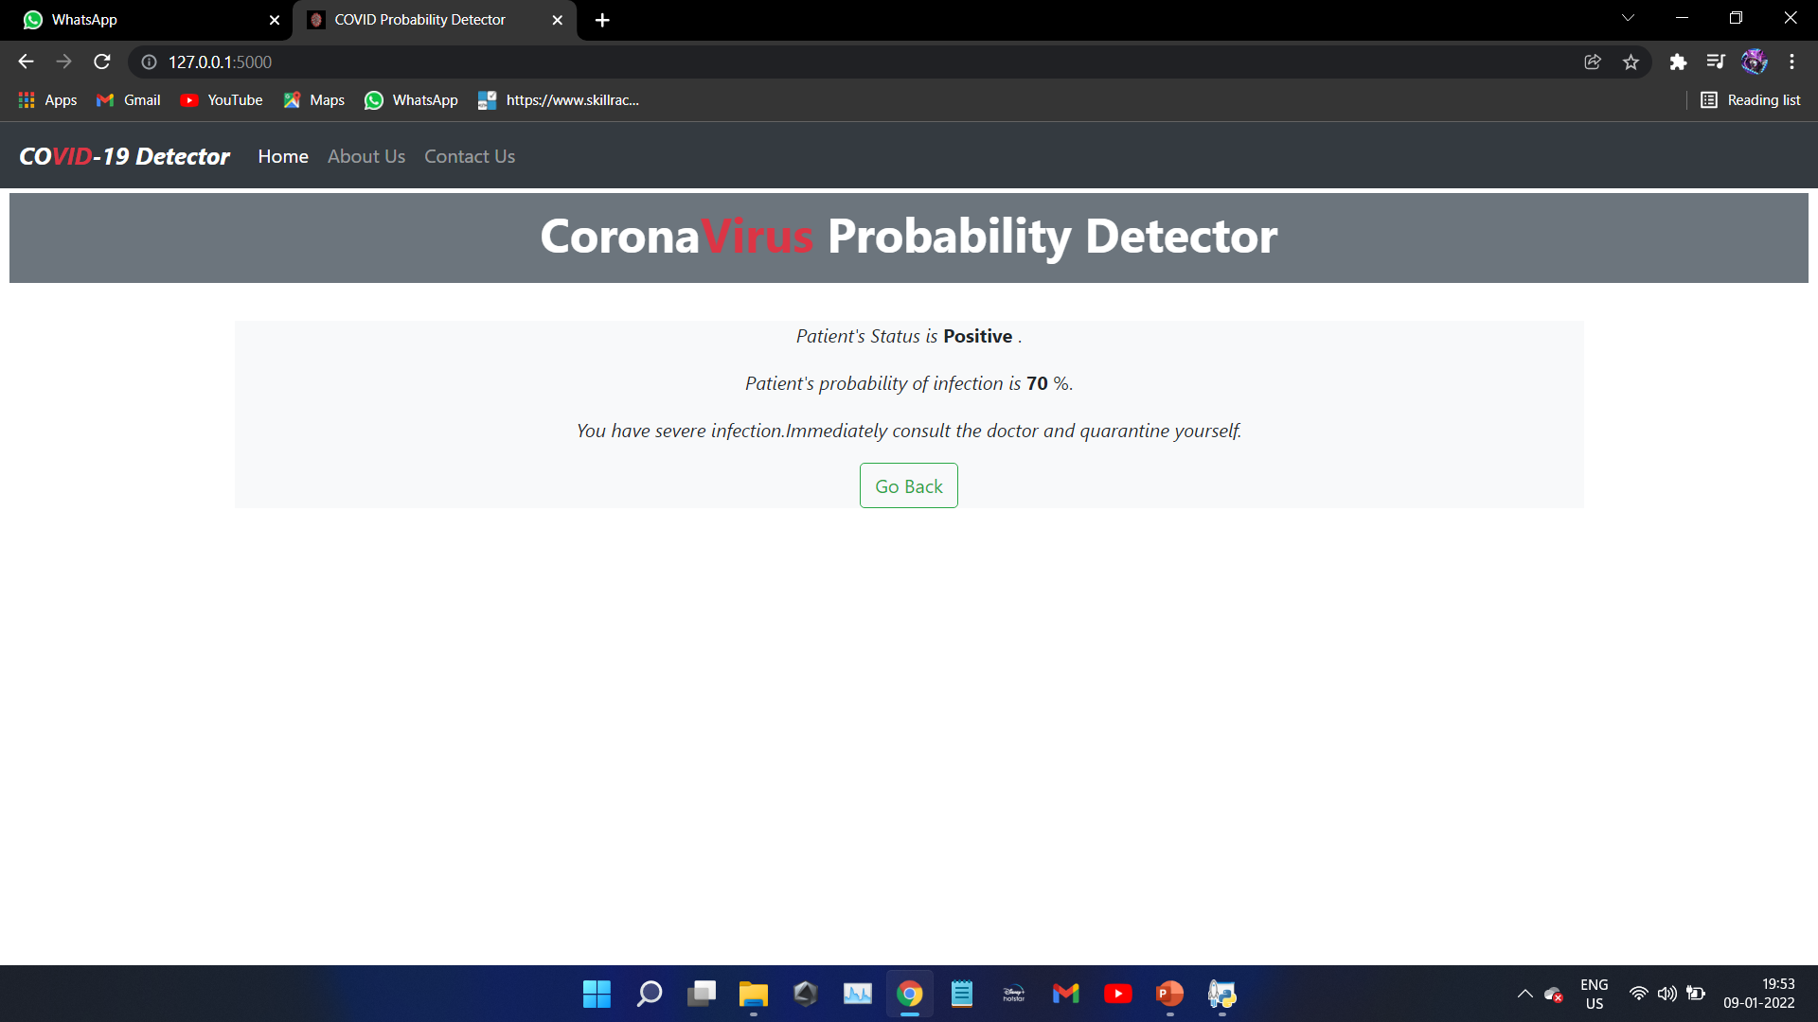
MP-1

Slide 19
PROS AND CONS OF THE SOLUTION
PROS OF THE SOLUTION:
Patients can be monitored from a safe distance, so nobody is likely to be infected.
It has the ability to deliver higher quality care to patients.
Oxygen level can be monitored regularly by using pressure sensors in oxygen cylinders through mobile application.
Pulse oximeter is included when the oxygen saturation level drops below 94, we will get alert notifications.
IR Thermal sensor is embedded to monitor patient body temperature regularly.
Calculation of the Covid possibility percentage provides the health condition of the patient.
MP-2

Slide 20
PROS AND CONS OF THE SOLUTION
CONS OF THE SOLUTION:
Depending on the quality of sensor used the life and accuracy of the system improve.
It needs an uninterrupted internet connection to be active.
It needs some knowledge of this technology to implement.
MP-1

Slide 21
THANK YOU

